Slide 1
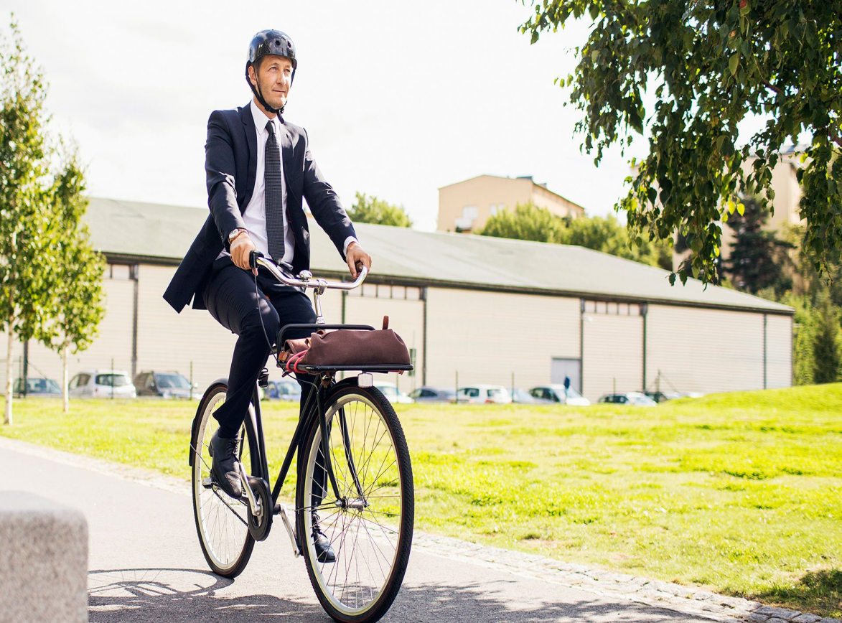
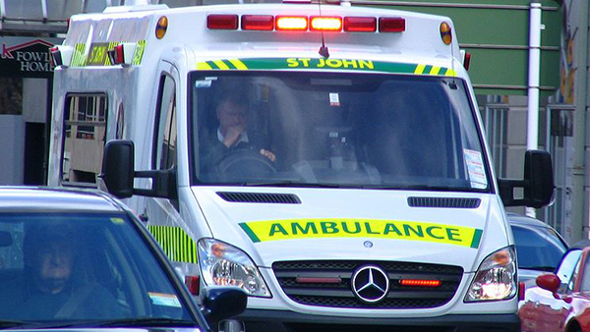

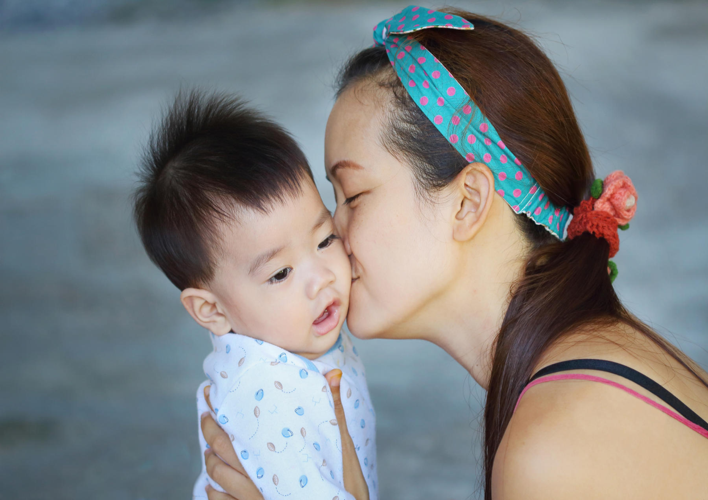
“HEALTH, ACCIDENTS AND EMERGENCIES, ILLNESSES AND INJURIES”

Slide 2
Operation, fit and pain,
Robust, therapy and cane.

Slide 3
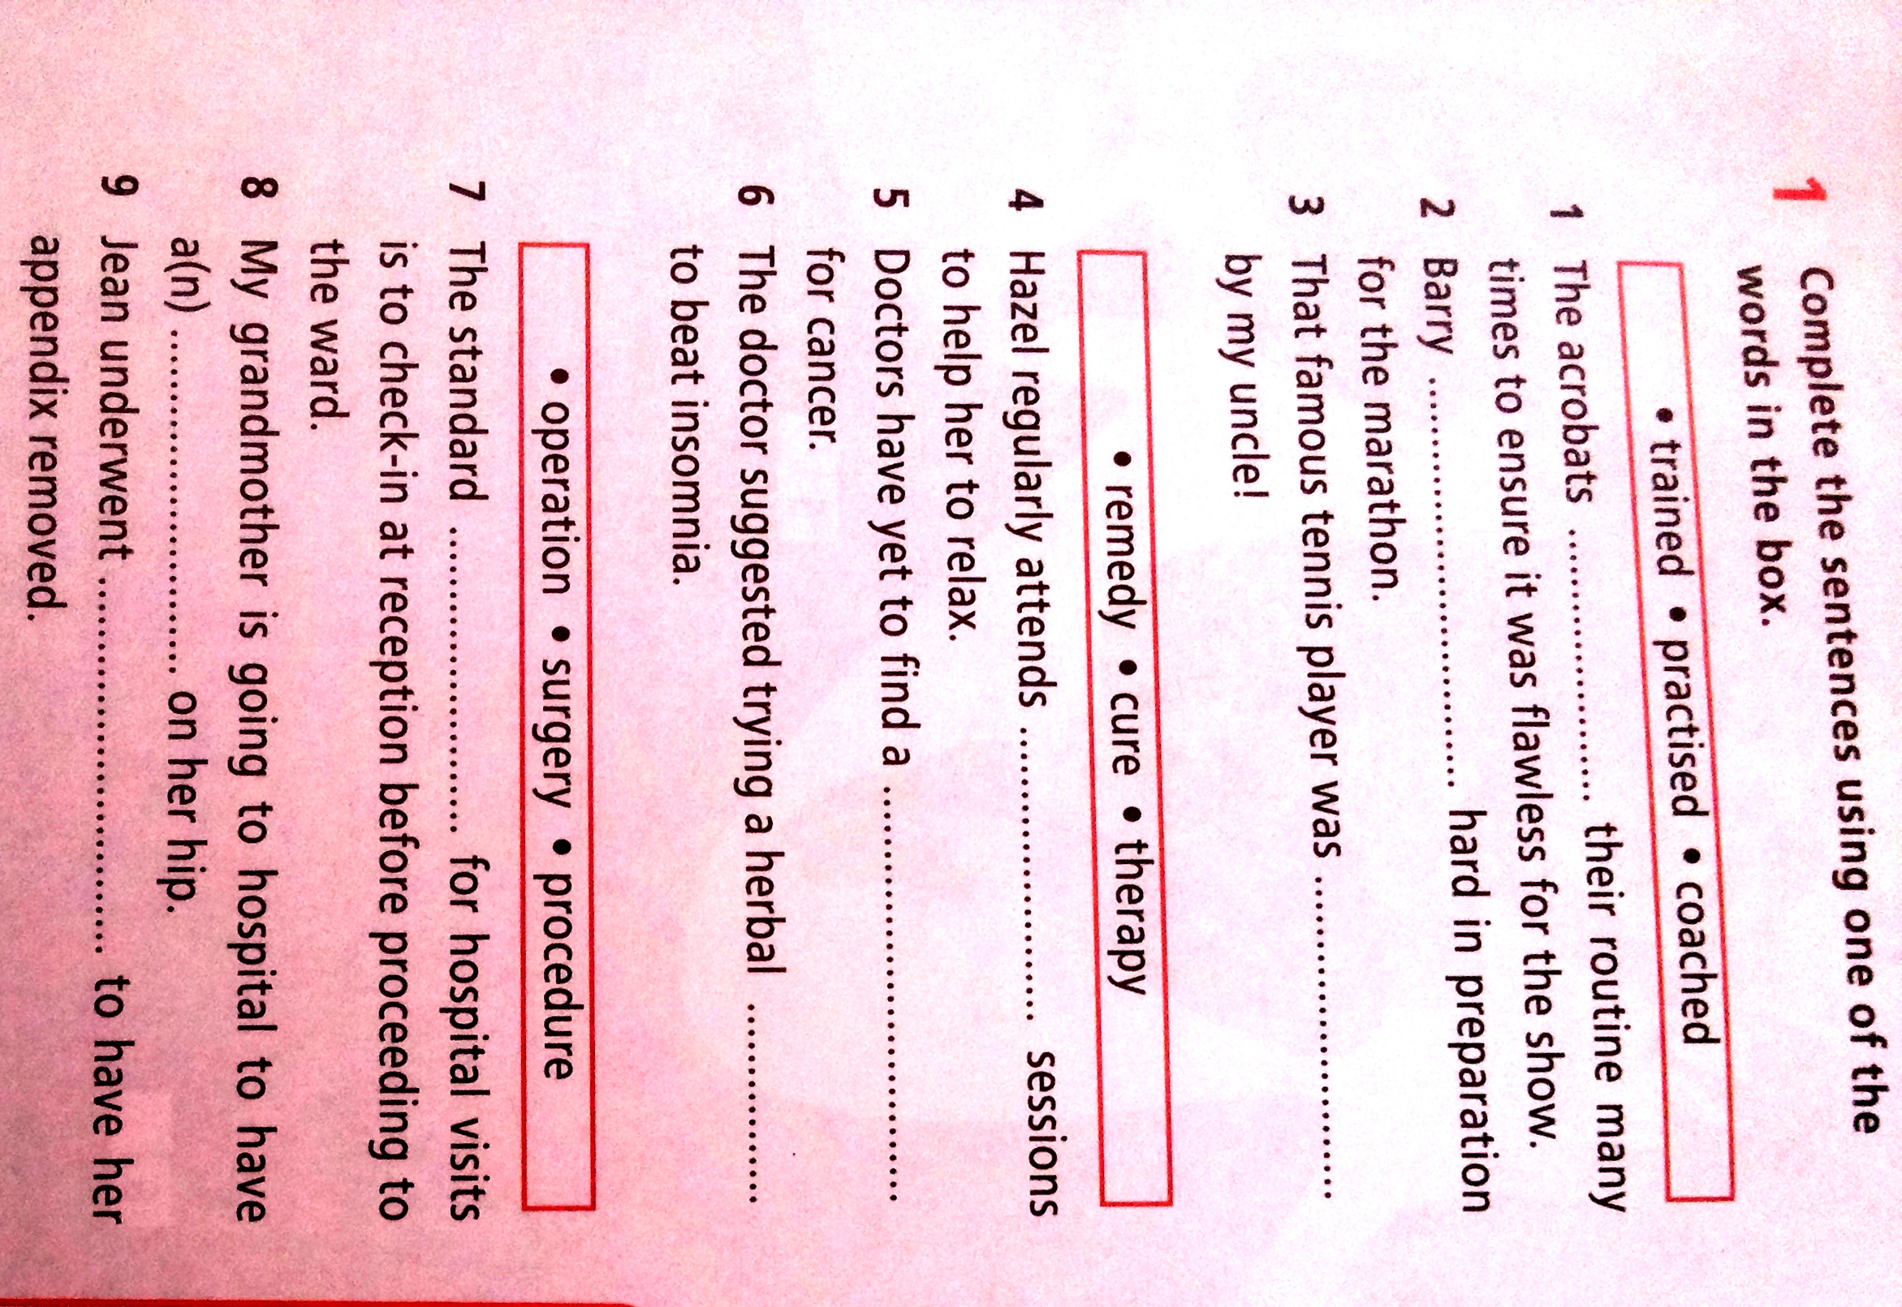

Slide 4
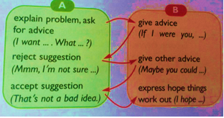

Slide 5
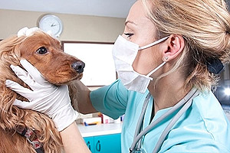

Сompare and contrast the photographs:
-give a brief description of the photos (action, location)
-say what the pictures have in common
-say in what way the pictures are different
-say which kind of the activities presented in the pictures you'd prefer
-explain why

